Slide 1
PREDICTION OF DISEASE USING MACHINE LEARNING

Slide 2
Presented by:
GUNDA NIKHIL – 700739893
RAMYA SAHITYA JAKKULA – 700737451
GURU PRASAD - 700742087

Slide 3
Description/Task | Responsibility - Person | Contributions - percentage
Data Read and Preprocessing | Ramya Sahitya Jakkula | 50%
Visualization | Nikhil Gunda | 50%
Model And result Analysis (DT and Fuzzy C Means) | Guru Prasad | 50%
Kmeans | Nikhil/Ramya | 80%
Result Analysis | Guru Prasad | 60%

Slide 4
Motivation:
It is necessary to upgrade medical facilities in order to make better choices regarding patient diagnosis and available treatments. Machine learning will play an important role in the healthcare industry to process huge and complex medical data sets and analyze them to extract therapeutic insights.
Doctors can use this to treat patients. As a result, when machine learning is employed in healthcare, patient will get better treatment.
In this work, we try to combine healthcare machine learning features into a single system. By implementing disease prediction using machine learning predictive algorithms, healthcare might be made smarter beyond only diagnosis.
In some cases, it may not be possible to make a timely diagnosis of a disease. Therefore, disease prediction can be effectively put into practice. Prediction of diseases and epidemic outbreaks might result in an early prevention of a disease's emergence, as it is often said, "Prevention is better than cure."

Slide 5
Objectives:
In order to evaluate the risk of sickness, we used both structured and unstructured data in this study. Reconstructing missing data from medical records obtained from the hospital using the latent factor model method. Additionally, by using statistical knowledge, we may pinpoint the main chronic diseases that affect a given area and population. When working with structured data, we consult with hospital experts to learn about crucial details. We employ the c-mean method to automatically detect features in unstructured text data. We provide a c-mean technique for both structured and unstructured data.

Slide 6
Related Work
Paper Name: Disease phenol type similarity improves the prediction of novel disease associated micro RNAs Author: Duc-Hau Le
The role of miRNAs (microRNAs) in human disease has been implicated in numerous research. A number of computational methods have been developed to predict these relationships by classifying prospective microRNAs in accordance with their applicability to various diseases. Network-based approaches are becoming more popular because they effectively utilize the "disease module" concept in functionally related miRNA networks. A functional similarity network miRNA is used in the cutting-edge algorithm-based Random Walk with Restart (RWR) technique known as RWRMDA. The use of this strategy was encouraged by its success in identifying disease genes because the idea of a "disease module" also appears in protein interaction networks. A number of additional algorithms have also been developed to forecast disease genes. They haven't, however, been applied to disease microRNA prediction.

Slide 7
Related Work Cont.
2. Paper Name: Defining Disease Phenotypes in Primary Care Electronic Health Records by a Machine Learning Approach: A Case Study in Identifying Rheumatoid Arthritis Author: Shang-Ming Zhou[2]
Variables were chosen by comparing the relative frequencies of Read codes in the primary care dataset associated with disease cases versus non-disease controls (disease/non-disease based on secondary care diagnosis); ii) predictors/associated variables were reduced using a Random Forest method; and iii) decision rules were inferred from decision tree models. The suggested method was then thoroughly verified on a separate dataset and its performance was compared to two existing deterministic algorithms for RA created with expert clinical knowledge.

Slide 8
Related Work Cont.
3. Paper Name: Design and Implementing Heart Disease Prediction Using Naives Bayesian Author: Anjan Nikhil Repaka, Sai Deepak Ravikanti
Dataset selection, application-based user registration and login, Bayesian Navy categorization and prediction, and stable data transfer using AES are all phases of the offered approach (Advanced Encryption Standard). The outcomes are then produced. By utilizing data mining technologies for heart disease prediction, the work elaborates and provides numerous information abstraction strategies. The results imply that the diagnostic framework created may predict heart disease risk factors with accuracy. [3]

Slide 9
Proposed Framework
Fuzzy c-means algorithm: Each point in fuzzy clustering has a chance of being a member of each cluster, as opposed to only being a member of one cluster as in normal k-means. In Fuzzy-C Means clustering, each point has a weight associated with a certain cluster; as a result, a point does not necessarily "belong" to a cluster but rather has a weak or strong link to it, which is decided by the inverse distance to the cluster's center.
Speed: Because fuzzy-C means perform more work, they typically run more slowly than K means. With each cluster, each point is assessed, and each evaluation necessitates more operations. While fuzzy c means also need to calculate distance, K-Means simply needs to do so. should utilize complete inverse-distance weighting.My personal opinion is that FCM/Soft-K-Means is "less foolish" than Hard-K-Means when it comes to extended clusters.

Slide 10
Methodology
Machine learning is the field that makes predictions using historical data. The idea behind machine learning is that a computer system can learn from data and experience. Two phases make up the machine learning algorithm: 1) Testing and 2) Training Using a patient's symptoms and medical history, machine learning technology has been working for decades to predict disease. Healthcare issues can be effectively handled with the use of machine learning technology.
To keep an eye on our patients' health, we are deploying comprehensive machine learning techniques. We can create models using ML that quickly clean, process, and provide results. This method will enable doctors to make accurate assessments of patient diagnoses and, as a result, give the proper treatment to the patient, improving patient healthcare services. The medical industry's potential use of machine learning in healthcare is very well illustrated.

Slide 11
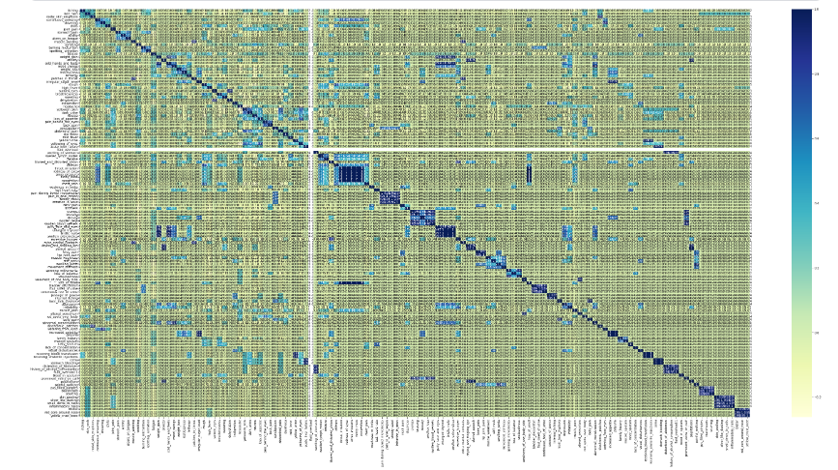
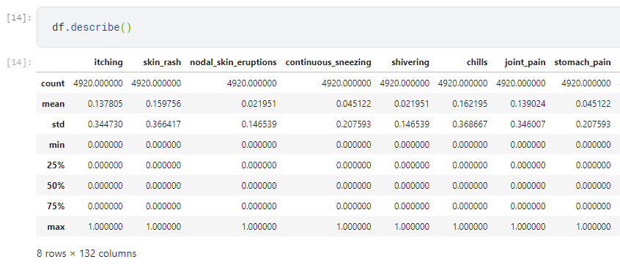
Result
Correlation graph
Data Stats

Slide 12
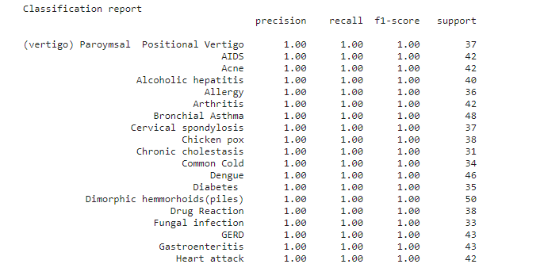
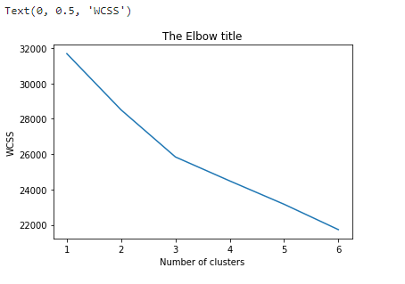
Result Cont.
Classification Report
K-Means Cluster

Slide 13
References:
Min Chen, Yixue Hao, Kai Hwang, Fellow, IEEE, Lu Wang, and Lin Wang "Disease Prediction by Machine Learning from Healthcare Communities" (2017).
Mr. Chala Beyene and Prof. Pooja Kamat, "Survey on Prediction and Analysis of Heart Disease Occurrence Using Data Mining Techniques," International Journal of Pure and Applied Mathematics, 2018.
P. Groves, B. Kayyali, D. Knott, and S. V. Kuiken, 2016. "The 'big data' revolution in healthcare: Accelerating value and innovation."
S.-H. Wang, T.-M. Zhan, Y. Chen, Y. Zhang, M. Yang, H.-M. Lu, H.-N. Wang, B. Liu, and P. Phillips, "Multiple sclerosis identification using biorthogonal wavelet transform, rbf kernel principal component analysis, and logistic regression," IEEE Access, vol. 4, no. 4, pp. 7567-7576, 2016.
S. Patel and H. Patel, "Survey of data mining techniques utilised in the healthcare domain," International Journal of Informatics Science and Technology, Vol. 6, pp. 53-60, March 2016.

